Slide 1
Graph Neural Networks
Some slides adapted from Rose Yu or Jure Leskovec

Slide 2
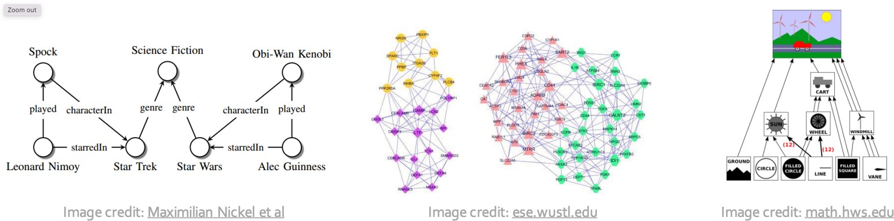
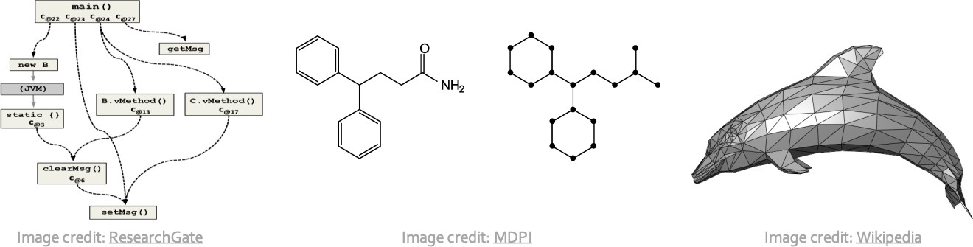
Graph Data
knowledge graph
Protein interactions
scene graphs
code graphs
molecules
3D shapes
slides adapted from Jure Leskovec lectures

Slide 3
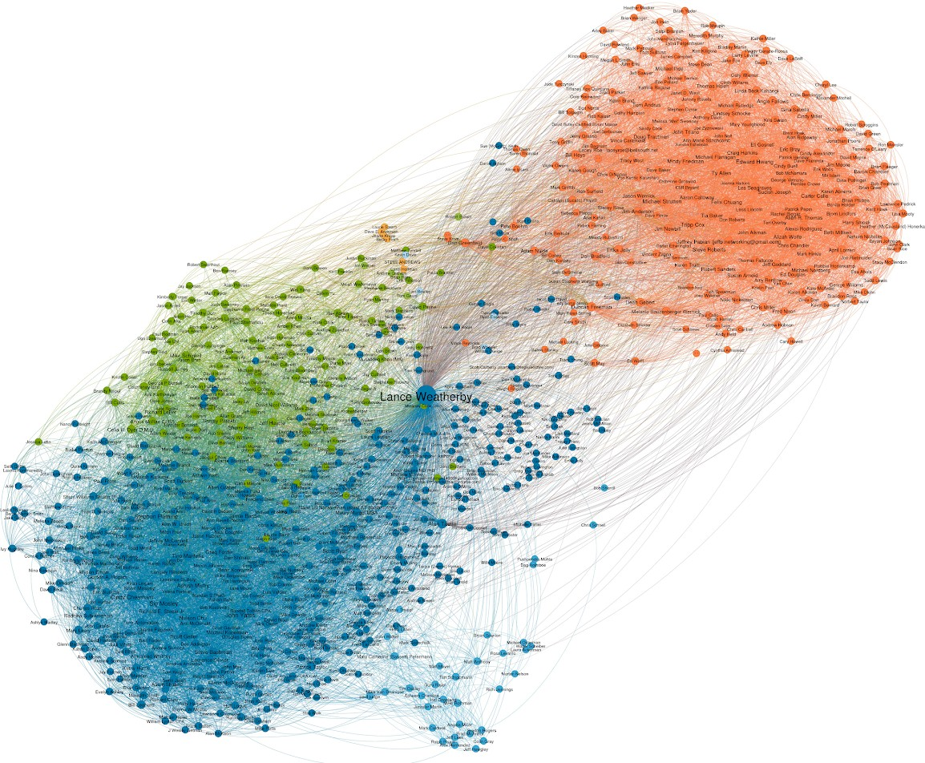
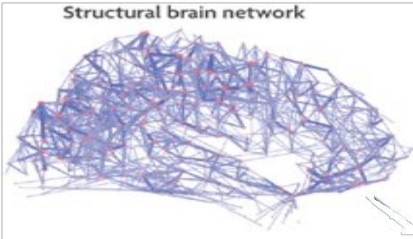
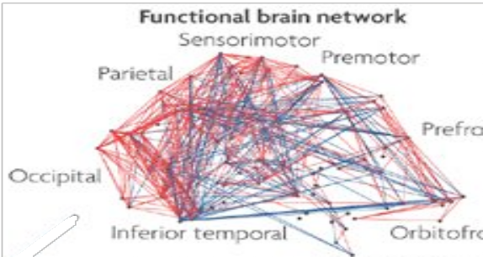


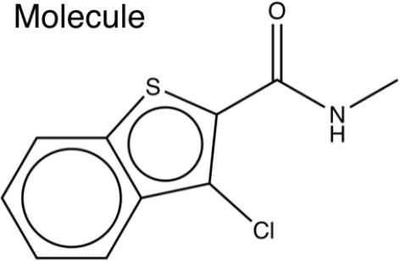
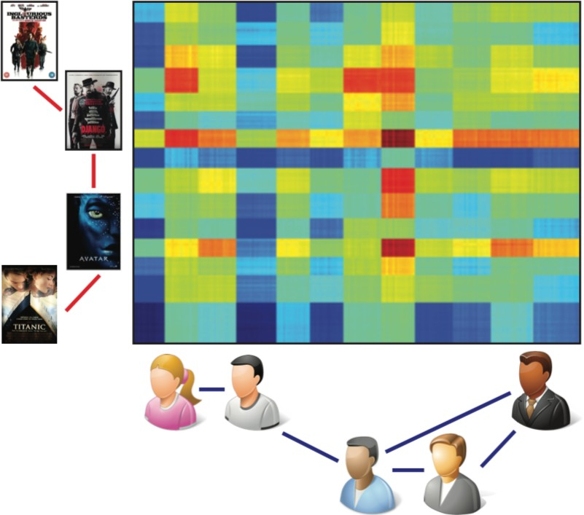
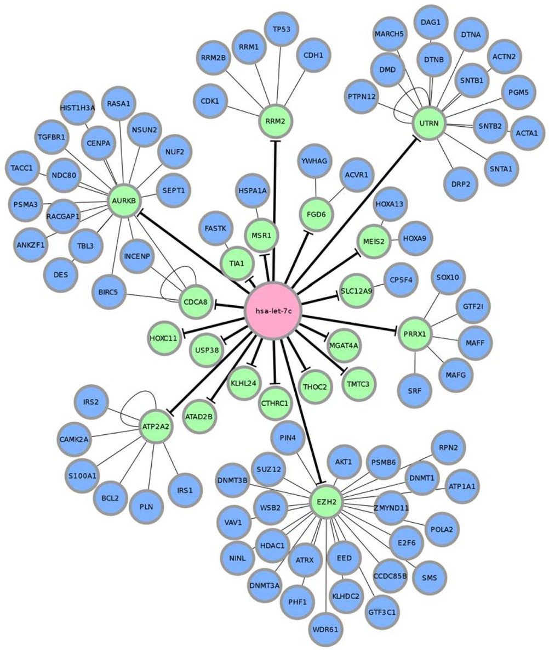
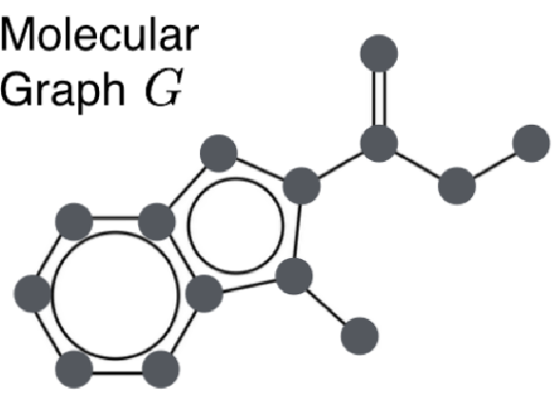
Graph-structured data
https://towardsdatascience.com/geometric-foundations-of-deep-learning-94cdd45b451d

Slide 4
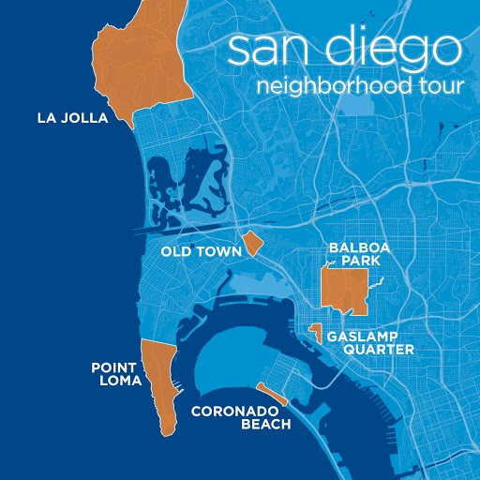
Graph Data Contain Structure
locality: connected areas tend to contain stronger patterns
permutation invariance: only the connectivity of nodes matters. They have no specific order.

Slide 5
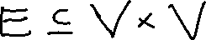
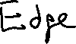
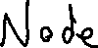
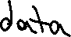
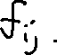
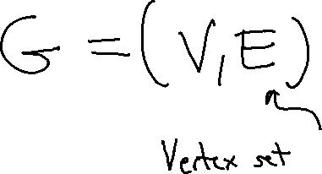
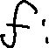
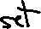
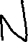
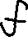
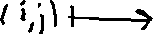
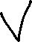
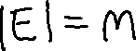
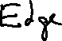
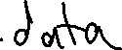
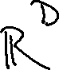
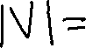
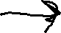
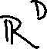
Graph Definition

Slide 6
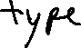
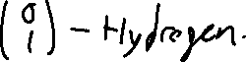
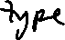
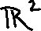
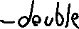
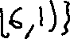
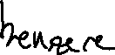
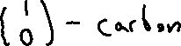
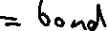
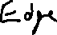
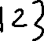
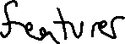
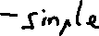
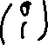
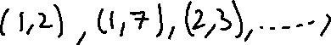
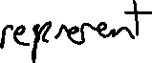
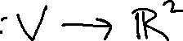
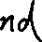
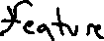

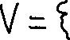
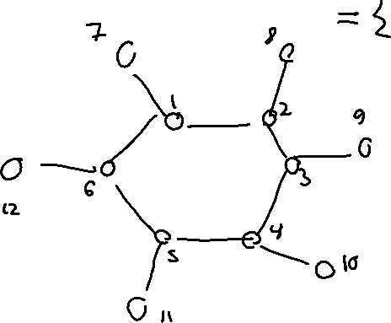





Example

Slide 7























Example

Slide 8



















Slide 9




















Graph Datum

Slide 10






















Important Property: Permutation Invariance

Slide 11




Important Property: Permutation Invariance

Slide 12

























Important Property: Permutation Invariance

Slide 13







Tasks on Graphs
node/link classification recommendation traffic forecasting
Hamilton et al., 2017
Li et al., 2018
drug discovery
fluid simulation
protein folding
Zitnick et al. 2018
Sanchez-Gonzalez et al. 2020
Jumper et al., 2021

Slide 14

























Learning Problem: Node Classification

Slide 15











Learning Problem: Node Classification

Slide 16















Learning Problem: Node Classification

Slide 17






























Learning Problem: Graph Classification

Slide 18
Q: How do we build Neural Networks which incorporate 1) local graph geometry and 2) permutation-equivariance / permutation-invariance?

Slide 19
Q: How do we build Neural Networks which incorporate 1) local graph geometry and 2) permutation-equivariance / permutation-invariance? A: We can draw inspiration from other geometric methods such as CNNs

Slide 20




Challenge
Cannot apply CNN to a fixed-size sliding window, each node has a different number of neighbors
There is no spatial relationship among the neighbors, i.e. no top, bottom, left, right neighbor

Slide 21
Graph Convolutional Networks
How to extend convolution to graphs?
What does it mean to translate a filter on a graph?
How to share weights?
How to define pooling between layers?
What is “local” on a graph? Neighborhoods are not all the same size

Slide 22
Spatial Graph Convolution
A node’s state is based on aggregating its neighbor states
Define convolution in terms of node neighborhood
Update each node’s state as aggregation of neighbors states
Computations are over a few nodes, not entire graph

Slide 23





2D Convolution in terms of Neighborhoods

Slide 24
















2D Convolution in terms of Neighborhoods

Slide 25
2D Convolution in terms of Neighborhoods

Slide 26

















Slide 27






























Slide 28
















Slide 29
















Slide 30
Matrix Form

Slide 31









Matrix Form

Slide 32






Matrix Form

Slide 33




Matrix Form

Slide 34











Permutation Equivariance

Slide 35





















Permutation Equivariance

Slide 36

















Permutation Equivariance

Slide 37





Message-Passing Perspective
∑ Wh_{u})
u∈N(v)
h_{v} =σ(

Slide 38


















Neural Network Structure Mirrors Graph Structure

Slide 39




Flavors of GNNs

Slide 40

Expressivity of GNNs
Theorem GNNs cannot express functions which are not expressible by 1-Weisfeiler-Leman message-passing algorithms.
Morris, Christopher, et al. "Weisfeiler and leman go neural: Higher-order graph neural networks." Proceedings of the AAAI conference on artificial intelligence. Vol. 33. No. 01. 2019.
Can’t distinguish these two graphs.

